Slide 1
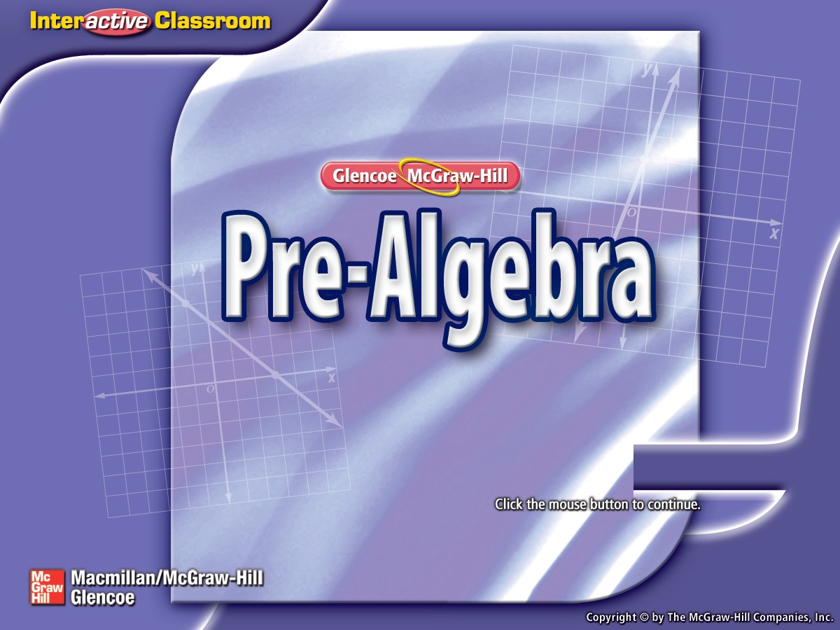
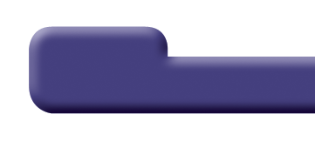

Splash Screen

Slide 2
Lesson Menu
Five-Minute Check (over Lesson 3–2)
Then/Now
Key Concept: Multiplying Fractions
Example 1: Multiply Fractions
Example 2: Multiply Negative Fractions and Mixed Numbers
Example 3: Evaluate Rational Expressions Using Multiplication
Example 4: Real-World Example: Multiply Fractions by Whole Numbers

Slide 3

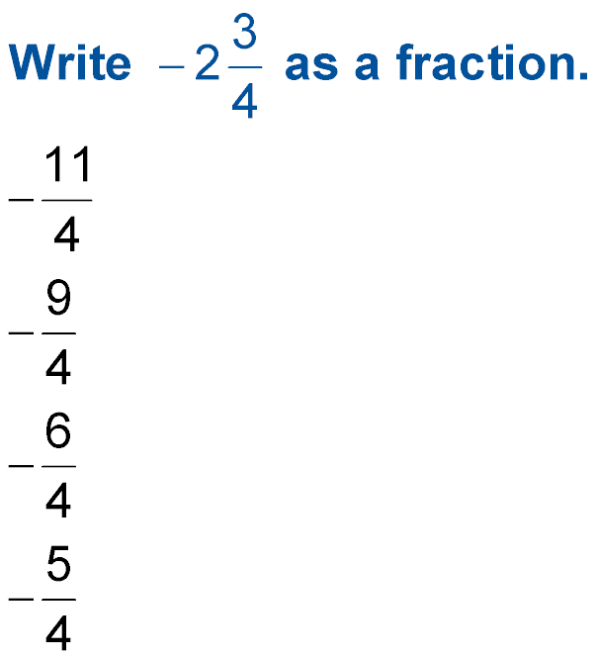
5-Minute Check 1
A.
B.
C.
D.

Slide 4


5-Minute Check 2
Write 29 as a fraction.
A.
B.
C.
D.

Slide 5

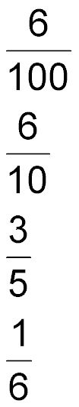
5-Minute Check 3
Write 0.6 as a fraction in simplest form.
A.
B.
C.
D.

Slide 6

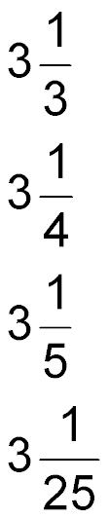
5-Minute Check 4
Write 3.25 as a mixed number in simplest form.
A.
B.
C.
D.

Slide 7

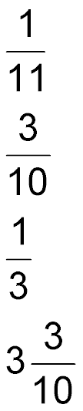
5-Minute Check 5
_
Write 0.3 as a fraction in simplest form.
A.
B.
C.
D.

Slide 8


5-Minute Check 6
Which of the following fractions is between
0.20 and 0.25?
A.
B.
C.
D.

Slide 9


Then/Now
You have already multiplied positive fractions. (Previous Course)
Multiply positive and negative fractions.
Evaluate algebraic expressions with fractions.

Slide 10
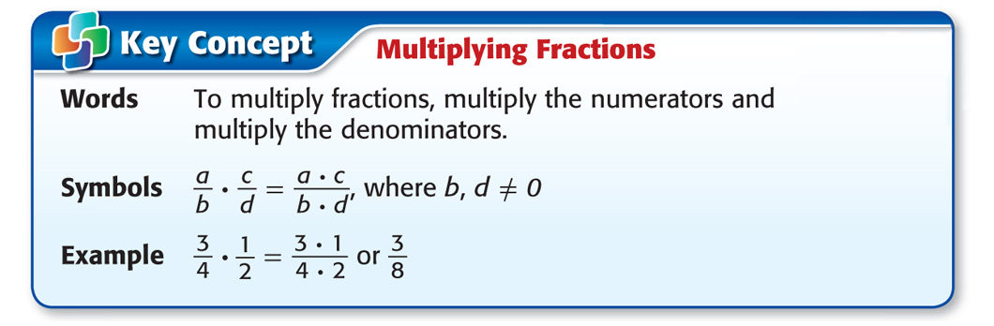
Concept

Slide 11
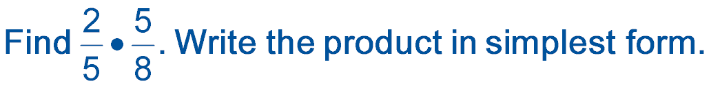
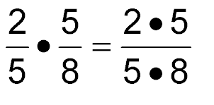
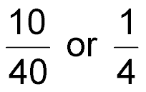
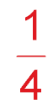
Example 1
Multiply Fractions
Multiply the numerators.
Multiply the denominators.
Simplify. The GCF of 10 and 40 is 10.
Answer:

Slide 12


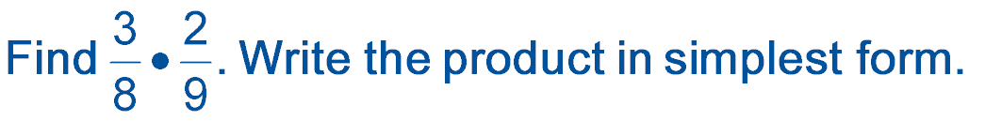

Example 1
A.
B.
C.
D.

Slide 13

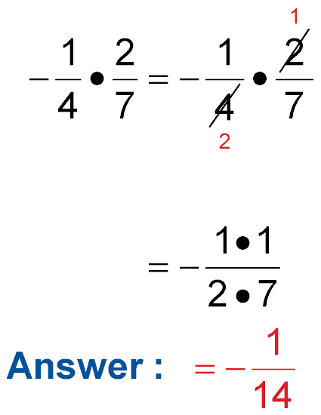
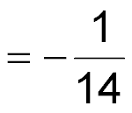
Example 2
Multiply Negative Fractions and Mixed Numbers
A.
Divide 2 and 4 by their GCF, 2.
Multiply the numerators and multiply the denominators.
Simplify.
Answer:

Slide 14
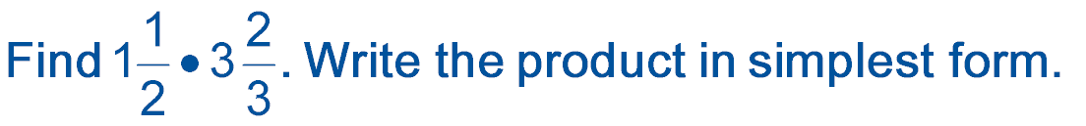
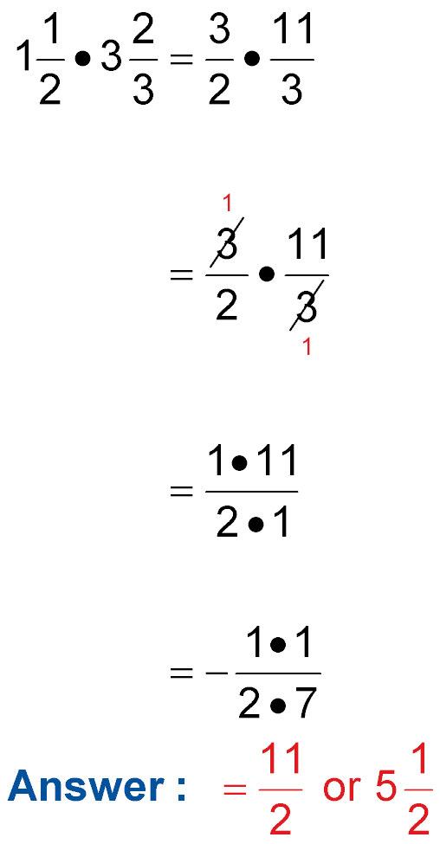
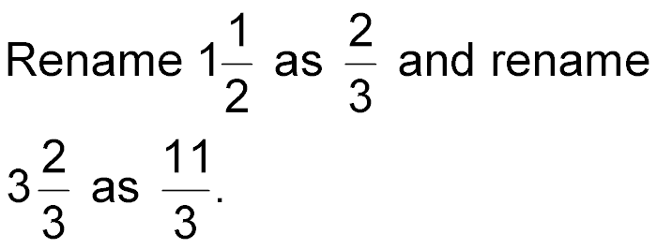

Example 2
Multiply Negative Fractions and Mixed Numbers
B.
Divide by the GCF, 3.
Multiply.
Answer: Simplify.

Slide 15

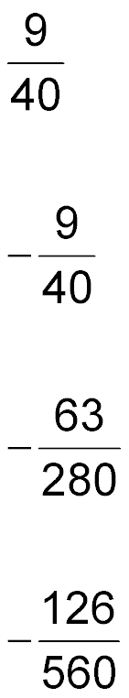
Example 2
A.
A.
B.
C.
D.

Slide 16

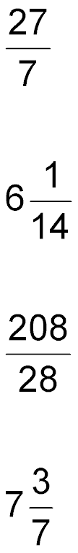
Example 2
B.
A.
B.
C.
D.

Slide 17
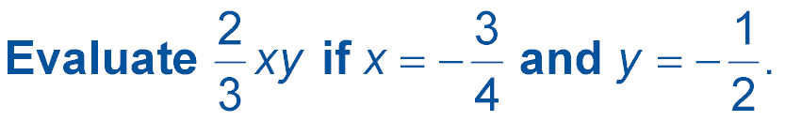
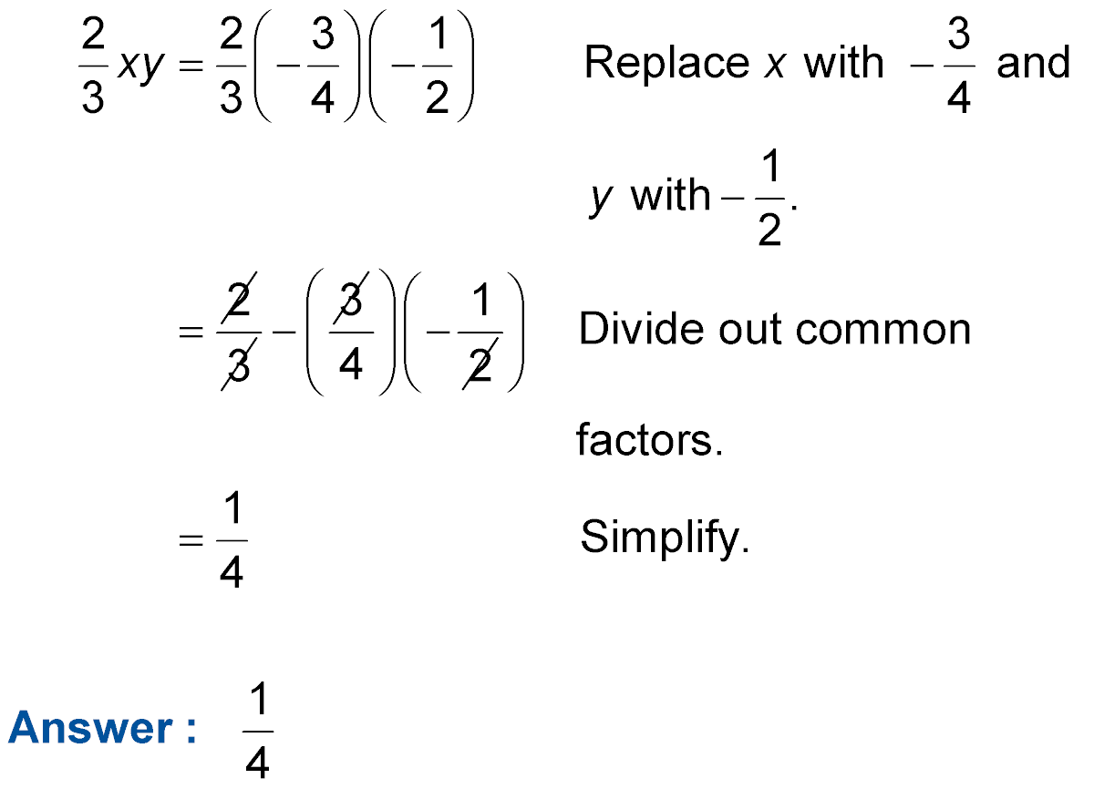
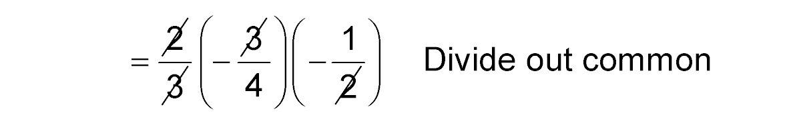
Example 3
Evaluate Rational Expressions Using Multiplication
1
1
1
1

Slide 18

Example 3
Evaluate Rational Expressions Using Multiplication

Slide 19
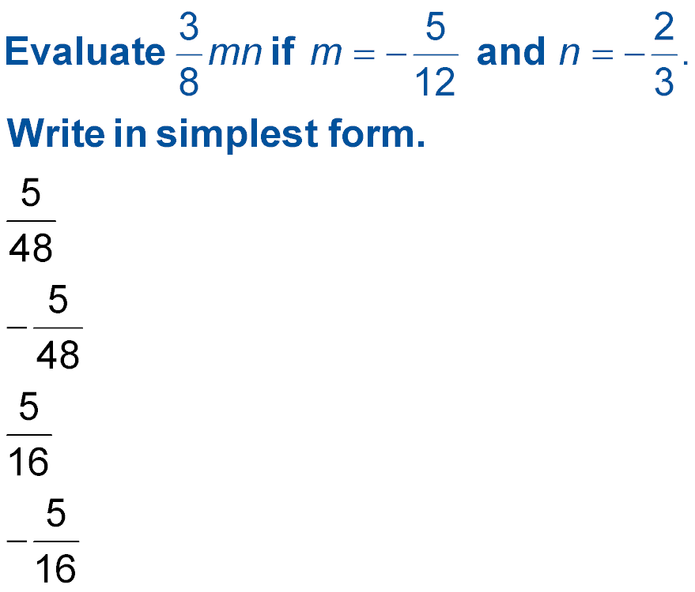
Example 3
A.
B.
C.
D.

Slide 20
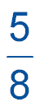

Example 4
Multiply Fractions by Whole Numbers
DONATIONS Rasheed collected cash donations for underprivileged children every October. This October he collected $784. Last year he collected
as much. How much did Rasheed collect last October?
To find how much Rasheed collected last October multiply 784 by

Slide 21
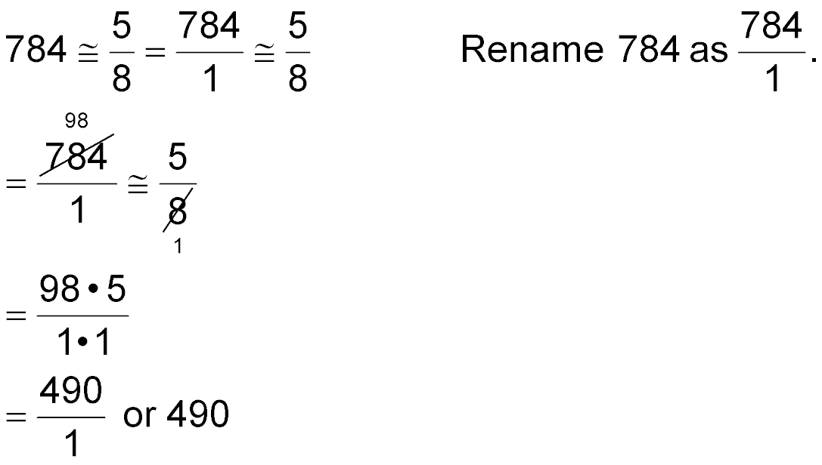
Example 4
Multiply Fractions by Whole Numbers
Divide by the GCF, 8.
Multiply.
Simplify.
Answer: Rasheed collected $490 last October.

Slide 22

Example 4
SHOPPING Melissa is buying a sweater originally priced for $81. The sweater is discounted by
Find the amount of the discount.
A. $64.00
B. $54.00
C. $50.67
D. $27.00

Slide 23
End of the Lesson

